Slide 1
AN EFFICIENT PROCESSING OF SPATIO TEMPORAL AGGREGATE QUERIES
EXTERNAL GUIDE
Dr. NISHAD A
INTERNAL GUIDE
Prof. VAHEETHA SALAM
(ASSOCIATE PROFESSOR)
PRESENTATION BY
FARHANA A REHIM
TKM21MCA-2018

Slide 2
TABLE OF CONTENT
SL NO | CONTENT
1 | KEY POINTS
2 | INTRODUCTION
3 | RELATED WORK
4 | GAP IDENTIFIED
5 | METHODOLOGY

Slide 3
KEY POINTS
A moving object refers to an object or entity that changes its position over time. It could be a physical object such as a car, a bird, or a person.
A moving object at time t can be represented in the form O(id, x, y, t). The coordinates (x, y) indicate latitude and longitude of the moving object and t is the time in which the object resides the location (x, y). The position (x, y) is called spatial component and ti is its temporal component.
A trajectory is a sequence of points or positions that describe the movement of a moving object over time.
A trajectory is a representation of a moving object, which is typically stored as a series of points with timestamps.

Slide 4
Semantic properties are contextual information of the moving object trajectories.These information comprise of the direction of movement, the velocity of the object, stop points etc.
A moving object query, also known as a spatiotemporal query, is a query used to retrieve information about objects that have a specific location and are moving over time.

Slide 5
1. INTRODUCTION

Slide 6
The recent advancement in positioning, telemetry and telecommunication technologies has led to generation of voluminous amount of moving object data.
Querying and analyzing of this data can give more insightful knowledge on the pattern of the mobility of the object and on the interest evinced by visitors in a geographic location.
In this paper, a new algorithm called SemTraClus is introduced which helps in identifying, clustering and prioritizing semantic regions.
Significant locations of a geographical area called Points of Interests are extracted using three main methods stay point detection,revisited locations and intersecting points of different trajectories.

Slide 7
These identified regions are clustered using DBSCAN method and finally it generates a Weightage Participation value which provides priorities of user interest in different semantic cluster regions.
This is the first work that clusters multiple trajectories for the identification of semantic points,considering spatial and temporal features simultaneously and providing prioritized location list.

Slide 8
2. RELATED WORK
Core Paper: Nishad, A. and Abraham, S., 2021. SemTraClus: an algorithm for clustering and prioritizing semantic regions of spatio-temporal trajectories. International Journal of Computers and Applications, 43(8), pp.841-850.

Slide 9
SL NO | TITLE OF THE PAPER,JOURNAL NAME,PUBLISHER,YEAR | PROS OF THE PAPER | CONS OF THE PAPER
1 | Bogorny V, Renso C, Aquino AR, et al. Constant – a conceptual data model for semantic trajectories of moving objects. Trans GIS. 2014;18(1): 66–88. | The author introduced a model called Constant model that provide a more comprehensive and meaningful representation of trajectories, which can lead to more accurate and effective analysis and decision-making. | The Constant model is relatively complex, with four main components and user-defined functions. This complexity may make it difficult for practitioners to understand and apply the model.
2. | Spaccapietra S, Parent C, Damiani ML, et al. A conceptual view on trajectories. Data Knowl Eng. 2008;65(1):126–146 | The authors discuss various operations and queries that can be performed on trajectories, which can be useful for research purpose | The paper focuses primarily on the conceptual framework for trajectories, and does not provide a detailed analysis or evaluation of specific algorithms or techniques for trajectory analysis.

Slide 10
3 | Alvares LO, Bogorny V, Kuijpers B, et al. A model for enriching trajectories with semantic geographical information. In: Proceedings of the 15th Annual ACM International Symposium on Advances in Geographic Information Systems. ACM; 2007. p. 22 | This paper provides an innovative and practical model for enriching stop points with semantic geographical information, which can be useful for researchers and practitioners working in various domains, such as transportation, urban planning, and environmental monitoring. | It is only designed for processing single trajectory.
4 | Rocha, J.A.M., Times, V.C., Oliveira, G., Alvares, L.O. and Bogorny, V., 2010, July. DB-SMoT: A direction-based spatio-temporal clustering method. In 2010 5th IEEE international conference intelligent systems (pp. 114-119). IEEE. | This paper present a novel approach to find interesting places in trajectories, considering the variation of the direction as the main aspect.They use direction based spatio temporal clustering method. | This paper has limited evaluvation since it is only using a single dataset.
5 | Alamri, S., Taniar, D. and Safar, M., 2014. A taxonomy for moving object queries in spatial databases. Future Generation Computer Systems, 37, pp.232-242 | Provides a clear and organized structure for understanding different types of moving object queries | The taxonomy may be too broad or too specific.

Slide 11
3. GAP IDENTIFIED
Existing models focuses on processing single trajectory at a time .
It is difficult to process entire data due to limitations of system resources in terms of space and time.
Moving objects are points that change their locations over time , which requires a higher update frequency,this has caused database being flooded with data from various sources.
Querying of moving object data is very complex therefore it can be computationally expensive.
Inorder to solve the above stated issues, the proposed method can identify semantic points by clustering multiple trajectories and providing a prioritized list.

Slide 12
4. OBJECTIVE
The main objective is to propose a system that cluster multiple trajectories for identification of semantic points.
To develop a system that provides a prioritized list of semantic points.
To implement a model that simplifies querying and analysis of moving object data.
To propose a system that reduces the complexity and time for processing the data.

Slide 13
METHODOLOGY

Slide 14
5.1 DATASET
MICROSOFT GEOLIFE TRAJECTORY DATASET
This GPS trajectory dataset was collected in (Microsoft Research Asia) Geolife project by 178 users in a period of over four years (from April 2007 to October 2011).
This dataset contains 17,621 trajectories with a total distance of 1,251,654 kilometers and a total duration of 48,203 hours.
This dataset recorded a broad range of users outdoor movements in Beijing which include going to work,shopping,hiking etc.
In this trajectory file every single folder of this dataset stores a user’s GPS log files, which were converted to PLT format.

Slide 15
PLT format:
Line 1…6 are useless in this dataset, and can be ignored. Points are described in following lines, one for each line.
Field 1: Latitude in decimal degrees.
Field 2: Longitude in decimal degrees.
Field 3: All set to 0 for this dataset.
Field 4: Altitude in feet (-777 if not valid).
Field 5: Date - number of days (with fractional part) that have passed since 12/30/1899.
Field 6: Date as a string.
Field 7: Time as a string.

Slide 16
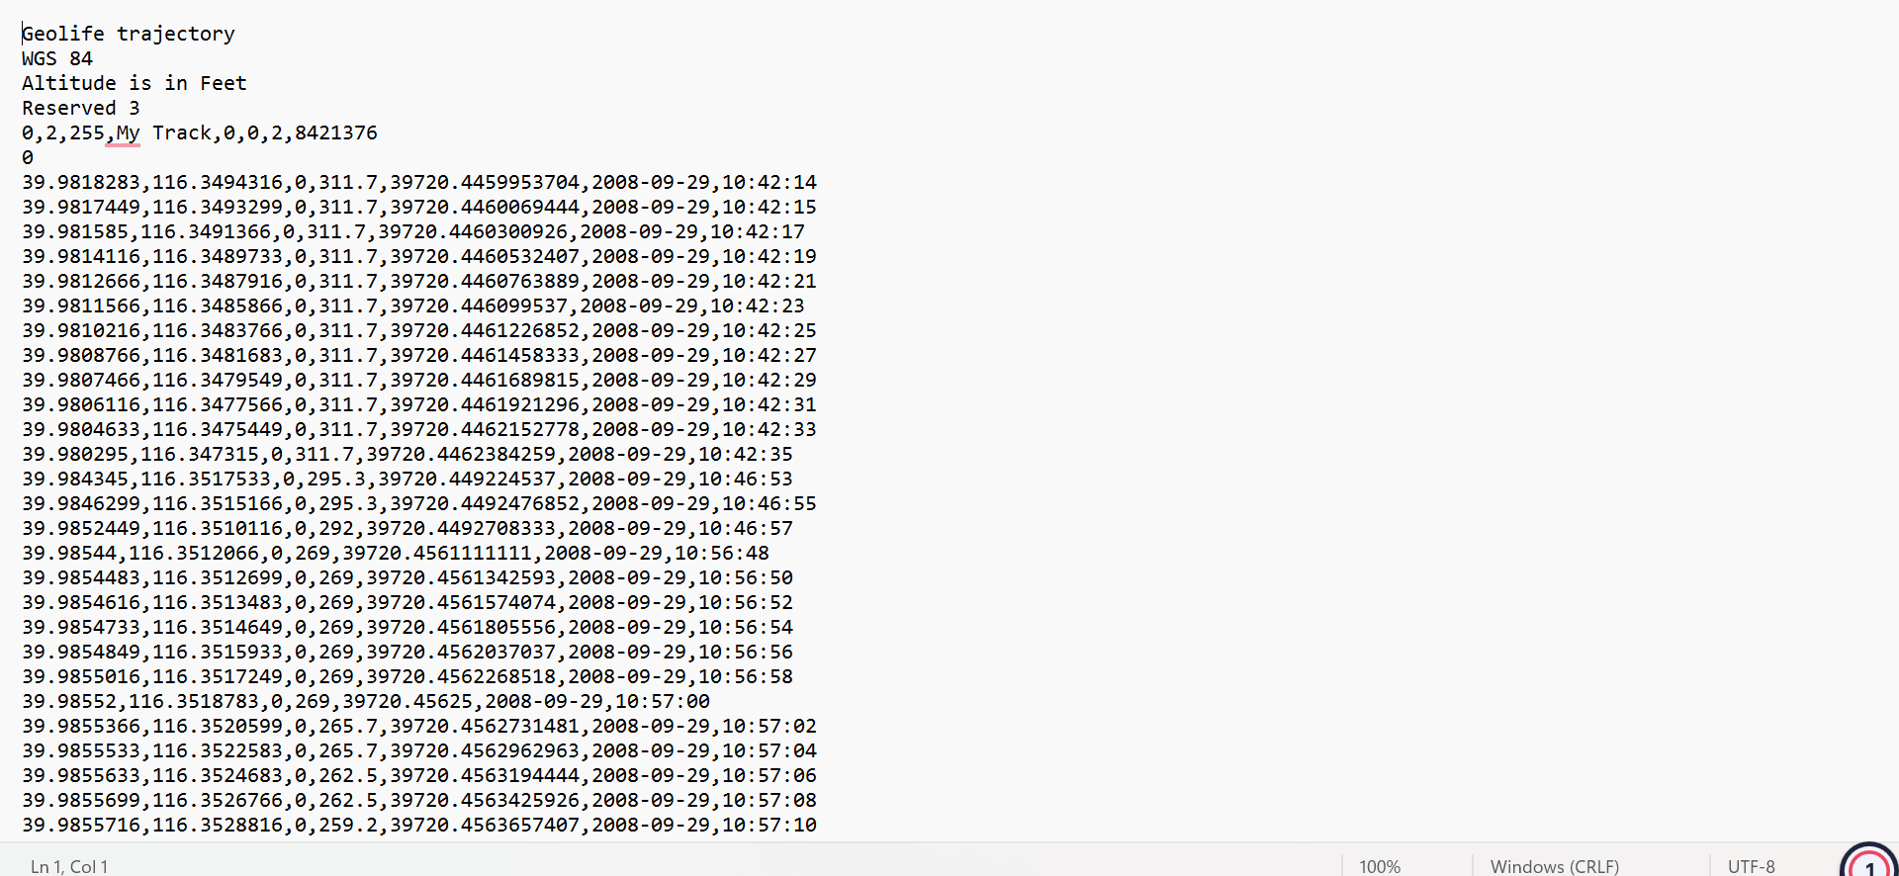

Slide 17
5.2 DATA PREPERATION
Analyzing the dataset
Removing unwanted data.
Identifying files with similar sizes
Identifying files with stay points

Slide 18
5.3 SemTraClus Algorithm
The majority of the existing techniques for the semantic point identification are focused on single trajectories. But if we choose a geographical area, we can observe that more meaningful places can be mined by accounting different movement tracks collectively. We are bridging this gap in research by the introduction of SemTraClus.
First phase of the algorithm excavates meaningful locations using stay points detection, revisited locations and intersecting points of different trajectories.

Slide 19
5.3.1 STAY POINT DETECTION
Staying point detection is a process used to identify locations where an object has remained stationary for a period of time.
These points can also be called as “point of interest”.
Different algorithms are used to check if the distance between consecutive trajectory points are below certain threshhold and the total time stayed in that point is greater than a fixed duration , if so they are considered as stay points.

Slide 20
The algorithms used are :
Euclidean Distance - It is a measure of the distance between two points in a two or higher-dimensional space.
The Euclidean distance between two points (p1, p2) and (q1, q2) in a two-dimensional plane is
calculated using the following formula:
d = sqrt((q1 - p1)^2 + (q2 - p2)^2)
Haversine Formula - The Haversine formula is a mathematical equation used to calculate the great-circle distance between two points on the surface of a sphere, such as the Earth.
The Haversine formula is expressed as:
d = 2r * arcsin(sqrt(sin^2((lat2 - lat1)/2) + cos(lat1) * cos(lat2) * sin^2((lon2 - lon1)/2)))

Slide 21
Manhattan Distance - Manhattan distance is a distance metric used to calculate the distance between two points in a grid-like structure, such as a city block or a chessboard . The Manhattan distance between two points (x1, y1) and (x2, y2) is calculated by taking
the absolute difference between their x-coordinates and their y-coordinates, and the summing those differences:
d = |x2 - x1| + |y2 - y1|

Slide 22
Currently working on storing the stay points in a table using MySQL and check if the stay points have been revisisted.
The revisited points will also be stored in another table.
Next step is to find the points where trajectories are intersecting with each other .
The second phase include clustering of identified geographical locations using density based clustering tool called DBSCAN and assignment of Weightage participation to its users and
identifies semantic locations.

Slide 23
THANK YOU!

